Slide 1
CONFIGURATION MANAGEMENT

Slide 2
What is Configuration Management
A process that allows us to install your operating systems and software's automatically
Tracking and controlling of software changes in a system
It purpose is to ensure consistency in performance , functionality and design

Slide 3
Benefits of Configuration Management
Cost reduction by having detailed knowledge of all the elements of the configuration which allows for unnecessary duplication to be avoided..
Increased efficiencies, stability and control by improving visibility and tracking.
Decreased risk and greater levels of security.
Greater agility and faster problem resolution, thus giving better quality of service.
Faster restoration of service.

Slide 4
CURRENT CONFIGURATION MANAGEMENT

Slide 5





FIRST SCENARIO – Installation of Software on Employees Laptops Problem

Slide 6


FIRST SCENARIO – Installation of Software on Employees Laptops Proposed Solution
Log Request
Log Request
Log Request
Log Request

Slide 7
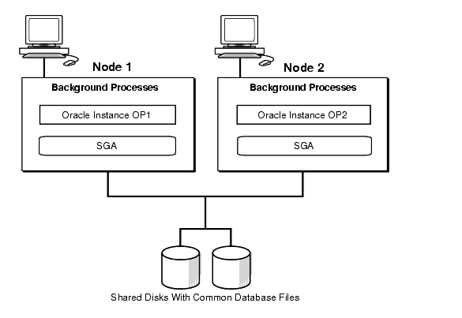
FIRST SCENARIO – Operation

Slide 8
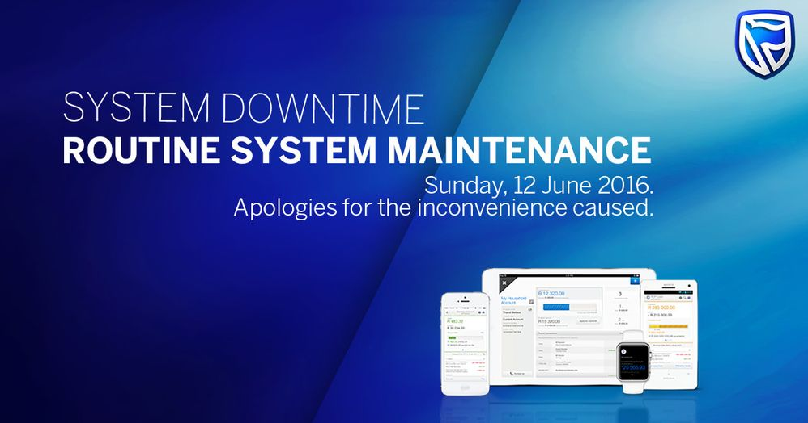
SECOND SCENARIO – Banking Website and Mobile Application Under Maintenance Problem

Slide 9

SECOND SCENARIO – Banking Website and Mobile Application Under Maintenance Proposed Solution

Slide 10
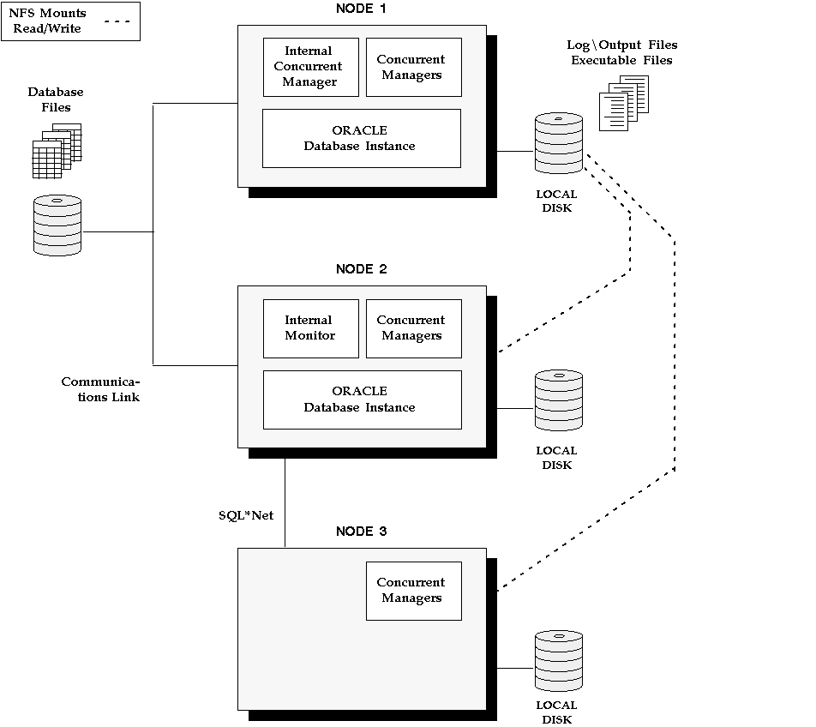
SECOND SCENARIO – Operation

Slide 11
THANK YOU

